Slide 1

ORACLE DATA GUARD 11g
AUTOMATION OF DATABASE RECOVERY

Slide 2
MANALI VERMA
B.TECH (CSE – 4th Year)
INDIRA GANDHI DELHI TECHNICAL UNIVERSITY FOR WOMEN

Slide 3

WHAT IS DATA GUARD ??

Slide 4
DATA GUARD
ORACLE states “An application-transparent high-performance low-impact asymmetrical online reliable Redo or SQL level background standby database transaction exchange utility capable of reporting, switchover and Failover.”
WHAT ???

Slide 5
SIMPLY ………
Oracle Data Guard is the management, monitoring, and automation software infrastructure that creates, maintains, and monitors one or more standby databases to protect enterprise data from failures, disasters, errors, and data corruptions.
Data Guard helps you to protect your Data.
Takes your data and automatically puts it Standby.
Makes it available for Failover in case of failure.
The other capabilities are pure bonus.
Switchover for Maintenance
Reporting
Off-loading Queries
Backups

Slide 6
Data Guard Oracle 11g New Features
Snapshot Standby
Standby can be converted to snapshot standby
Can be opened in read-write mode (for testing)
Redo transport continues
Redo apply delayed
Standby can subsequently be converted back to physical standby
Active Data Guard
Separately licensed option
Updates applied to primary
Changes can be read immediately on standby databases
Standby database can be opened in read-only mode
Redo can continue to be applied

Slide 7
Attributes
Attribute | Why Important
1. Redundancy with isolation | No single point of failure, failures stay put
2. Zero data loss | Complete protection, no recovery concerns
3. Extreme performance | Deploy for any application
4. Automatic failover | Fast, predictable
5. Full systems utilization | Fast recovery, high return on investment
6. Management simplicity | Reliable, reduced administrative costs

Slide 8
Protection Modes
Protection Mode
Failure Protection
Redo Shipping
Maximum Protection
Zero Data Loss
Protects Against Primary and Network Failure
LGWR using SYNC and SRL
Maximum Availability
Zero Data Loss
Protects Against Primary Failure
LGWR using SYNC
Maximum Performance
Best Effort Against Primary Failure
ARCH or LGWR using ASYNC

Slide 9
Maximum Protection Mode
Protection Mode
Failure Protection
Redo Shipping
Maximum Protection
Zero Data Loss
Protects Against Primary and Network Failure
LGWR using SYNC
Zero Data Loss!
Highest Level of Protection
Configuration: LGWR SYNC, SRLs
Enforces protection of every transaction
If last standby is unavailable, processing stops at primary
Good for financial systems where no data loss is acceptable
ALTER DATABASE SET STANDBY TO MAXIMIZE PROTECTION;
Notes:
All standby sites to be used in this mode must be defined with LGWR, SYNC and have SRLs and be reachable before the primary will start up.
Requires at least one site defined as above.
Other sites defined with other configurations will receive logs but cannot participate in the ‘mode’
No support for Logical standby sites in this mode. The active sites can exist but do not participate in the ‘mode’
Maximum protection mode offers the highest level of data availability for the primary database, ensuring a comprehensive zero-data loss disaster recovery solution. When operating in maximum protection mode, redo records are synchronously transmitted from the primary database to the standby database, and a transaction is not committed on the primary database until it has been confirmed that the transaction data is available on at least one standby database. This mode is usually configured with at least two standby databases, thus offering double failure protection. If the last participating standby database becomes unavailable, processing automatically halts on the primary database as well. This ensures that no transactions are lost when the primary database loses contact with all of its standby databases.
The maximum protection mode provides the highest degree of data protection at the standby site. However, it can potentially impact primary database performance. The impact on performance can be minimized by configuring a network with sufficient throughput for peak transaction load and with low round trip latency. Stock exchanges, currency exchanges, and financial institutions are examples of businesses that require maximum protection.

Slide 10
Maximum Availability Mode
Protection Mode
Failure Protection
Redo Shipping
Maximum Availability
Zero Data Loss
Protects Against Primary Failure
LGWR using SYNC
Zero Data Loss as long as the network stays up!
Enforces protection of every transaction
Configuration: LGWR SYNC
If last standby is unavailable, processing continues at primary
When the standby becomes available again, synchronization with the primary is automatic
ALTER DATABASE SET STANDBY TO MAXIMIZE AVAILABILITY;
Notes:
All standby sites to be used in this mode must be defined with LGWR, SYNC but do not need SRLs
Requires at least one site defined as above.
Logical sites are allowed to participate
Other sites defined with other configurations will receive logs but cannot participate in the ‘mode’
Maximum availability mode has the next highest level of data availability for the primary database, offering zero data loss and protecting against single component failures. As with the maximum protection mode, redo data are synchronously transmitted from the primary database to the standby database. The transaction is not complete on the primary database until it has been confirmed that the transaction data is available on the standby database. However, if a standby database becomes unavailable – say, because of network connectivity problems, processing continues on the primary database. The standby database may temporarily diverge from the primary database, but when it is available again, the databases will automatically synchronize, and no data will be lost.
This protection mode can potentially impact response time and throughput. These can be minimized by configuring a low latency network with sufficient throughput for peak transaction load.
An example of a business that can use this data protection mode is a manufacturing plant; the risks of having no standby database for a period of time and data divergence are acceptable as long as no data is lost if failover is necessary.

Slide 11
Maximum Performance Mode
Protection Mode
Failure Protection
Redo Shipping
Maximum Performance
Best Effort Against Primary Failure
ARCH or LGWR using ASYNC
Highest level of performance
Configuration: LGWR ASYNC, or ARCH
Protects from failure of any single component
Least impact on production system
Useful for applications that can tolerate some data loss
ALTER DATABASE SET STANDBY TO MAXIMIZE PERFORMANCE;
Notes:
Any defined site can be used.
LGWR ASYNC or ARCH modes.
Requires at least one site.
But will run with none.
Maximum performance mode is the default protection mode. It offers slightly less primary data protection, but higher performance, than maximum availability mode. In this mode, as the primary database processes transactions, log data is asynchronously shipped to the standby database. The commit operation of the primary database does not wait for the standby to acknowledge receipt before completing the write on the primary. If any standby destination becomes unavailable at any time, processing continues on the primary database and there is little or no effect on performance.
In the case of a failure of the primary, there may be some transactions that were committed on the primary that had not completed shipping to the standby. If the network has sufficient throughput to keep up with peaks in log traffic, the number of lost transactions should be very small or zero.
The maximum performance mode should be used when availability and performance on the primary database are more important than the risk of losing a small amount of data.

Slide 12


DATA GUARD PYRAMID
EM Data Guard Manager
Broker and CLI
Data Guard
Production /
Primary Databases
Physical and Logical Standby Databases

Slide 13
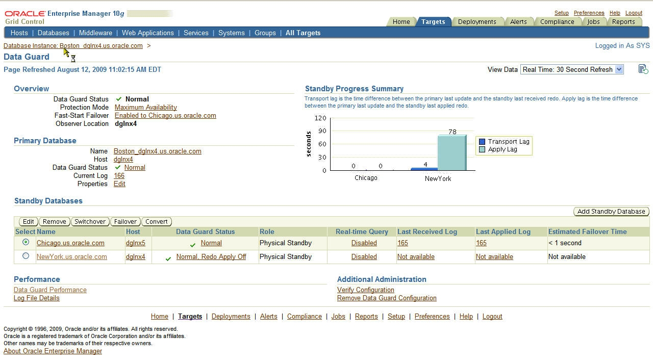
Oracle Enterprise Manager

Slide 14
Redundancy with Isolation
Data Guard Transport and Apply
Primary Database
Standby Database
Oracle Instance
1
SYNC or ASYNC
Oracle Instance
3
2
Automatic outage resolution
Oracle Data files
Oracle Data files
4
Recovery data
Recovery data

Slide 15
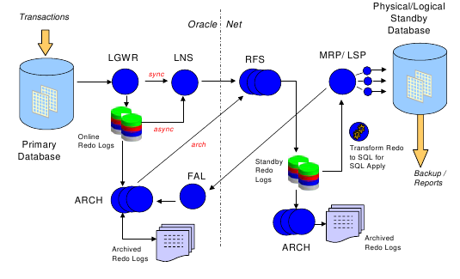
ARCHITECTURE

Slide 16

ARCHITECTURE Synchronous redo transport
User Transactions
Queries, Updates, DDL
Commit
Commit ACK
Active
Standby
Database
Primary Online Redo Logs
SGA
Redo Buffer
LGWR
Standby
Redo
Logs
NSA
RFS
MRP
Oracle Net
Primary
Database
Queries, Reports
Testing & Backups
Notes:
7

Slide 17
Data Guard Redo Log Shipping
ARCH background process
Copies completed redo log files to standby
LGWR background process - modes are:
ASYNC - asynchronous
Oracle 10.1 and below
redo written by LGWR to dedicated area in SGA
read from SGA by LNSn background process
Oracle 10.2 and above
redo written by LGWR to local disk
read from disk by LNSn background process
SYNC - synchronous
Redo written to standby by LGWR - modes are:
AFFIRM - wait for confirmation redo written to disk
NOAFFIRM - do not wait

Slide 18
Standby Redo Logs(SRL)
Guidelines when creating standby redo logs:
Number of standby redo logs should be the same number as online redo logs plus one.
Standby redo logs should be exactly the same size as the online redo logs.
SRLs should be created on both primary and standby to facilitate seamless role changes.
In a RAC environment, all SRLs should be on a shared disk and may be thread specific.
Used with maximum protection modes and when real-time apply is used.
How SRLs(Standby Redo Logs) work?
LGWR process on primary initiates a connection with standby.
Standby listener responds by spawning a process called RFS(remote file server)
RFS process creates n/w connection with processes on primary and waits for data to arrive.
Once data comes, RFS places it into standby redo logs.
When log switch occurs on primary, standby redo logs are switched and RFS will go to next available standby redo log.

Slide 19
Switchover and Failover
There are two operations to change roles in a standby configuration
Switchover
Changing roles with someone else and letting them take over while you become a standby
Failover
Assigning someone else to take over when the original boss is gone
Different steps for Physical and Logical Standby

Slide 20
SWITCHOVER PROCESS Switchover allows a primary and standby to reverse roles without any data loss.
Steps:
1. Verify if primary can be switched over to standby
SQL> select switchover_status from v$database;
If value returns “TO_STANDBY”, its alright to switch the primary to standby role.
2. Convert primary to standby
SQL> alter database commit to switchover to physical standby;
If value is “SESSIONS ACTIVE” from step 1, then
SQL> alter database commit to switchover to physical standby with session shutdown;
3. Shutdown the restart the old primary as standby
SQL> shutdown immediate;
SQL> startup mount;
At this point, we now have both databases as standby.
4. On target standby database, verify switchover status. If value is “TO_PRIMARY” then
SQL> alter database commit to switchover to primary;
If value is “SESSIONS ACTIVE”, then append “WITH SESSION SHUTDOWN” to above command.
5. Shutdown and restart the new primary database
SQL> shutdown immediate;
SQL> startup;

Slide 21
FAILOVER PROCESS Failover implies data loss and can result in the need to re-create old primary.
Steps:
1. Identify and resolve any gaps that may exist on standby.
SQL> select * from v$archive_gap;
Copy missing archives from primary to standby and register them to standby controlfile.
SQL> alter database register physical logfile ‘<archivepath>’;
2. If standby redo logs are configured and active,
SQL> alter database recover managed standby database finish;
If NO SRLs or they are not active,
SQL> alter database recover managed standby database skip standby logfile;
3. Convert standby to primary;
SQL> alter database commit to switchover to primary;
4. Restart new primary
SQL> shutdown immediate;
SQL> startup;
Note: Once the standby is made primary (read-write), verify redo logs and tempfiles

Slide 22
Key Best Practices Documentation
Active Data Guard and Redo Apply http://www.oracle.com/technology/deploy/availability/pdf/maa_wp_11gr1_activedataguard.pdf
Data Guard Redo Transport http://www.oracle.com/technology/deploy/availability/pdf/MAA_WP_10gR2_DataGuardNetworkBestPractices.pdf
Data Guard Fast-Start Failover http://www.oracle.com/technology/deploy/availability/pdf/MAA_WP_10gR2_FastStartFailoverBestPractices.pdf
Automating Client Failover (Data Guard 10g and 11gR1) http://www.oracle.com/technology/deploy/availability/pdf/MAA_WP_10gR2_ClientFailoverBestPractices.pdf
Managing Data Guard Configurations with Multiple Standby Databases http://www.oracle.com/technology/deploy/availability/pdf/maa10gr2multiplestandbybp.pdf
Data Guard Consulting Accelerator
http://www.oracle.com/consulting/offerings/platform/dataguardaccel_ds.html

Slide 23
Q
&
A
Q U E S T I O N S
A N S W E R S
Then Please Ask to Mr. A . S . DOBRE SIR

Slide 24

SOO MUCH FOR YOUR KIND ATTENTION !!! ☺ ☺

